Slide 1
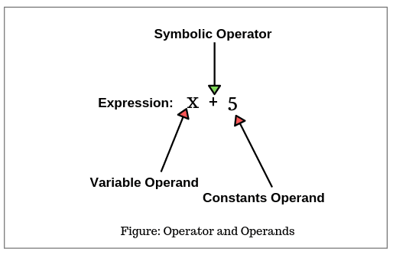
Operators in Java
In Java, an expression has two parts: operand and operator.
The variables or constants that operators act upon are called operands.
An operator in Java is a symbol or a keyword that tells the compiler to perform a specific mathematical or logical operations.

Slide 2
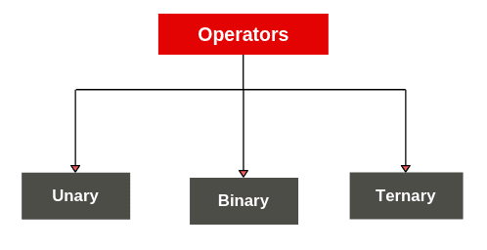
Types of Operators in Java
There are three types of operators in Java based on the number of operands used to perform an operation.

Slide 3
Types of Operators in Java
Unary operator: The operator that acts on a single operand is called unary operator. A unary operator uses a single variable.
Binary operator: The operator that acts on two operands is called binary operator. A binary operator uses two variables.
Ternary operator: The operator that acts on three operands is called ternary operator. A ternary operator uses three variables.
Based on the notation used, Java operators have been divided into two categories: Symbolic and named.
If a symbol like +, -, *, etc is used as an operator, it is called symbolic operator. If a keyword is used as an operator, it is called named operator.

Slide 4
symbolic operators and named operator
Arithmetic operators | +, -, *, /, %
Relational operators | <, >, <=, >=, = =, !=
Logical operators | &&, ||, !
Assignment operators | =, +=, -=, *=, /=, %=
Increment and decrement operators | + +, – –
Conditional operators | ?:
Bitwise operators | &, !, ^, ~, <<, >>, >>>
Shift operators | <<, >>, >>>
Named operator | instanceof operator

Slide 5
Arithmetic Operators in Java
Operator | Symbol | Description | Example
Addition Operator | + | Adds the left operand with the right operand and returns the result. | int a=10; int b=5; int c = a=b;
Subtraction Operator | – | Subtracts the left operand and right operand and returns the result. | int a=10; int b=5; int c = a-b;
Multiplication Operator | * | It multiples the left and right operand and returns the result. | int a=2; int b=3; int c=a*b;
Division Operator | / | Divides the left operand with the right operand and returns the result. | int a=10; int b=5; int c=a/b;
Modulo Operator | % | Divides the left operand with the right operand and returns the remainder. | int a=10; int b=5; int c=a/b;

Slide 6
Assignment operators
Symbol | Description | Example
= | Assign the right operand to the left operand. | int a=10; int b=20; a+=4; a=a+4 (a=10+4) b-=4; //b=b-4 (b=20-4)
+= | Adding left operand with right operand and then assigning it to variable on the left. | int a=5; a += 5; //a=a+5;
-= | subtracting left operand with right operand and then assigning it to variable on the left. | int a=5; a -= 5; //a=a-5;
*= | multiplying left operand with right operand and then assigning it to the variable on the left. | int a=5; a *= 5; //a=a*5;
/= | dividing left operand with right operand and then assigning it to a variable on the left. | int a=5; a /= 5; //a=a/5;
%= | assigning modulo of left operand with right operand and then assigning it to the variable on the left. | int a=5; a /= 5; //a=a/5;

Slide 7
Relational Operators
Operator | Symbol | Description | Example
Equal to | == | returns true of the left-hand side is equal to the right-hand side. | 5==3 is evaluated to be false.
Not Equal to | != | returns true of the left-hand side is not equal to the right-hand side. | 5!=3 is evaluated to be true.
Less than | < | returns true of the left-hand side is less than the right-hand side. | 5<3 is evaluated to false
Less than or equal to | <= | returns true of the left-hand side is less than or equal to the right-hand side. | 5<=5 is evaluated to be true
Greater than | > | returns true of the left-hand side is greater than the right-hand side. | 5>3 is evaluated to be true
Greater than or Equal to | >= | returns true of the left-hand side is greater than or equal to the right-hand side. | 5>=5 is evaluated to be true
Instance of Operator | instanceOf | It compares an object to a specified type. | String test = “asdf”; boolean result; result = test instanceOf String; //true

Slide 8
Logical Operators
Operator | Symbol | Description | Example
Logical OR | || | It returns true if either of the Boolean expressions is true. | false || true is evaluated to true
Logical AND | && | It returns true if all the Boolean Expressions are true | false && true is evaluated to false.
Logical NOT | ! | If the condition is correct, returns false. If the condition is false, returns true. | true -> false false -> true

Slide 9
Bitwise Operators
An operator that acts on individual bits (0 or 1) of the operands is called bitwise operator in Java.
It acts only integer data types such as byte, short, int, and long. Bitwise operators in java cannot be applied to float and double data types.
The internal representation of numbers in the case of bitwise operators is represented by the binary number system. Binary number is represented by two digits 0 or 1.
Therefore, these operators are mainly used to modify bit patterns (binary representation).

Slide 10
Types of Bitwise Operators
Operator | Symbol | Description | Example
Bitwise OR | | | It compares corresponding bits of two operands. If either of the bits is 1, it gives 1. If not, it gives 0. | int a=12, b=25; int result = a|b; //29
Bitwise AND | & | It compares corresponding bits of two operands. If either of the bits is 1, it gives 1. If either of the bits is not 1, it gives 0. | int a=12, b=25; int result = a&b; //8
Bitwise XOR | ^ | It compares corresponding bits of two operands. If corresponding bits are different, it gives 1. If corresponding bits are the same, it gives 0. | int a=12, b=25; int result = a^b; //21
Bitwise Complement | ~ | It inverts the bit pattern. It makes every 1 to 0 and every 0 to 1. | int a=35; int result = ~a; //-36

Slide 11
Unary Operators in Java
Operator | Symbol | Description | Example
Unary minus | – | It is used for negating the values. | int a=5.2; int b = -a; //-5.2
Unary plus | + | It is used for giving positive values. | int a=5.2; int b = +a; //5.2
Increment Operator | ++ | It is used for incrementing the value by 1. | int a=5.2; int b = ++a; //6.2
Decrement Operator | -- | It is used for decrementing the value by 1. | int a=5.2; int b = –a; //4.2
Logical NOT Operator | ! | It is used for inverting a Boolean value | boolean a=false; boolean b=!a; //true

Slide 12
Shift Operator in Java:
Operator | Symbol | Description | Example
Left Shift Operator | << | It is used to shift all of the bits in value to the left side of a specified number of times. | 10<<2 //10*2^2=10*4=40
Right Shift Operator | >> | It is used to move the left operand’s value to the right by the number of bits specified by the right operand. | 10>>2 //10/2^2=10/4=2

Slide 13
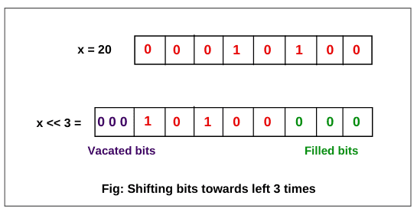
Left Shift Operator in Java
Key point: Shifting a value to the left, n bits, is equivalent to multiplying that value by 2^n.
For example: In the above expression, n = 3. So, 20 * 2^3 = 20 * 8 = 160.

Slide 14
Right Shift Operator in Java
There are two types of right shift operators in java:
1. Signed right shift operator (>>)
2. Unsigned right shift operator (>>>)
Both of these operators shifts bits of number towards right by n number of bit positions.
Key point: Shifting a value to the right is equivalent to dividing the number by 2^n.

Slide 15
Signed Right Shift Operator
The signed right shift operator >> shifts bits of the number towards the right and also reserves the sign bit, which is leftmost bit.
A sign bit represents the sign of a number.
If the sign bit is 0 then it represents a positive number.
If the sign bit is 1, it represents a negative number.
If the number is positive, the leftmost position is filled with 0.
If the number is negative, the leftmost position is filled with 1.
The signed shift operator uses the same sign as used in the number before shifting of bits.

Slide 16
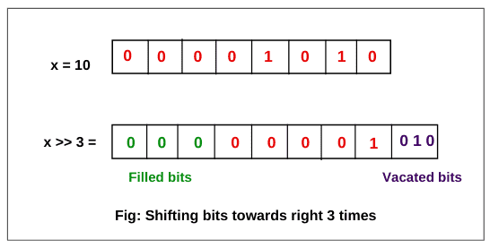
Signed Right Shift Operator
int x = 10; // positive number
x >> 3 // ?

Slide 17
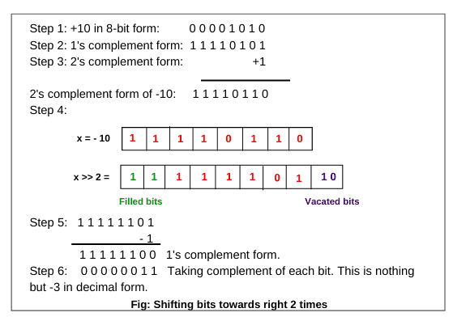
Signed Right Shift Operator
int x = -10; // positive number
x >> 2 // ?

Slide 18
Unsigned Right Shift Operator
The unsigned right shift operator in java performs nearly the same operation as the signed right shift operator in java.
The unsigned right shift operator is represented by a symbol >>>, read as triple greater than.
The unsigned right shift operator always fills the leftmost position with 0s because the value is not signed.
Since it always stores 0 in the sign bit, it is also called zero fill right shift operator in java.
Both signed right shift operator >> and unsigned right shift operator >>> are used to shift bits towards the right.
The only difference between them is that >> preserve sign bits whereas >>> does not preserve sign bit. It always fills 0 in the sign bit whether the number is positive or negative.

Slide 19
Ternary Operator in Java
The Ternary Operator in Java is also known as the Conditional Operator.
It is the shorthand of the if-else statement. It is the one-liner replacement of the if-else statement in Java.
It is called ternary because it has three operands.
The general format of the ternary operator is:
variable = exp1 ? exp2 : exp3;
where exp1, exp2, and exp3 are expressions.
example:
int a = 10;
int b = 20;
int x = (a > b) ? a : b;

Slide 20
Short circuit (&&, ||) operators:
These operators are exactly same as normal bitwise operators &(AND), |(OR) except the following differences.
x&&y : y will be evaluated if and only if x is true.(If x is false then y won't be evaluated i.e., If x is true then only y will be evaluated)
x||y : y will be evaluated if and only if x is false.(If x is true then y won't be evaluated i.e., If x is false then only y will be evaluated)
& , | | && , ||
Both arguments should be evaluated always. | Second argument evaluation is optional.
Relatively performance is low. | Relatively performance is high.
Applicable for both integral and boolean types. | Applicable only for boolean types but not for integral types.

Slide 21
Operator Precedence and Associativity in Java
Java has well-defined rules for specifying the order in which the operators in an expression are evaluated when the expression has several operators.
For example, multiplication and division have higher precedence than addition and subtraction. Precedence rules can be overridden by explicit parentheses.
Precedence and associative rules are used when dealing with hybrid equations involving more than one type of operator.
Precedence order:

Slide 22
Operator Precedence and Associativity in Java
Larger the number means higher the precedence.
Level | Operator | Description | Associativity
16 | [] . () | access array element access object member parentheses | left to right
15 | ++ — | unary post-increment unary post-decrement | not associative
14 | ++ — + – ! ~ | unary pre-increment unary pre-decrement unary plus unary minus unary logical NOT unary bitwise NOT | right to left

Slide 23
Operator Precedence and Associativity in Java
13 | () new | cast object creation | right to left
12 | * / % | multiplicative | left to right
11 | + – + | additive string concatenation | left to right
10 | << >> >>> | shift | left to right
9 | < <= > >= instanceof | relational | not associative
8 | == != | equality | left to right

Slide 24
Operator Precedence and Associativity in Java
7 | & | bitwise AND | left to right
6 | ^ | bitwise XOR | left to right
5 | | | bitwise OR | left to right
4 | && | logical AND | left to right
3 | || | logical OR | left to right
2 | ?: | ternary | right to left
1 | = += -= *= /= %= &= ^= |= <<= >>= >>>= | assignment | right to left

